Slide 1

Conceptual Depth
Behind Function Point Estimation
Krishnamurty Pammi, 09th January 2006.

Slide 2






Do we ever estimate…
Estimation We do in every walk of life.. Is isn’t?...

Slide 3


Can we Estimate Accurately?
Estimation is all about it.
We need Structured Methodology to learn this Skill

Slide 4

Let us take Practical Case…
You are looking to buy an apartment
You liked three apartments in three different areas
You have to take make a choice.
How do we do it?

Slide 5
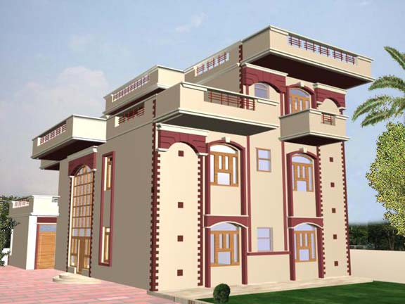
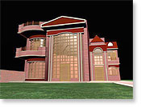
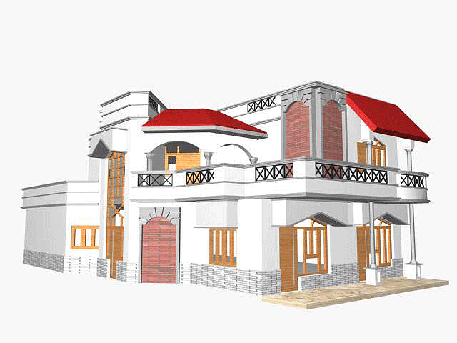
Area 1
Area 3
Area 2

Slide 6
How Cost is Derived.
 | Type | Size (A) | Unit Cost (B) | Total Cost (A * B)
Land
Labor
Material
Construction
Inventory
Registration
Electrical
Water
Sanitary
Furniture and Fixtures
Total Cost
Per Square Feet Cost

Slide 7
What the builder tells you
 | Per Square Feet Cost | Amenities Provided
Area 1
Area 2
Area 3
 | Area1 | Area2 | Area3
Two Bed Room of 1300 Sq. Feet
Two Bed Room of 1500 Sq. Feet
Three Bed Room of 2000 Sq Feet
Per Square Feet Cost is the smallest meaningful unit to the end User.
The Unit is technology independent, methodology independent and competency independent

Slide 8



Let us take our Case…
TOP MANAGEMENT
CLIENT
Client should be satisfied (repeat business)
Should be done using minimum resource
and in minimum time
Keep the bottom line
Should include all functionality under the sun
Should be delivered yesterday!!
All parties, with conflicting expectations should
be kept as happy as possible.
To achieve this, the project has to be controlled
PROJECT MANAGER
ARCHITECT
Should use all latest technologies irrespective
of its cost or its need for the problem at hand.
Should prove to be a S/W architectural
milestone in history.
Will not accept any deadlines.
TEAM MEMBERS
Should use all latest technologies irrespective
of its cost or its need for the problem at hand.
PM should take all responsibilities.

Slide 9
Why Function Point?
COST
SIZE
EFFORT
COST
SCHEDULE
RISKS
SCOPE
SCHEDULE
QUALITY
We want “End User Recognizable Smallest Meaningful Units” so that we can weigh all the above parameters.
We can address the same using Function Point Count.
Function Point Analysis is technology and Methodology Independent.

Slide 10
What is Function Point
End User Recognizable smallest meaningful Unit.
It breaks the system into smaller components, so that they can better understood and analyzed.
It provides the count through which we can estimate the Size of the Application.
Effort, Cost, Productivity and Schedule can be derived From Size of the Application.

Slide 11
Let us Take Software System
PAYROLL
SYSTEM
Employee IT
Declaration
Payroll
Data Base
EMPLOYEE PAYSLIP
IT PROJECTIONS
Application Boundary
MY DATA
HR
SYSTEM

Slide 12
Fundamental units of the System
Let us Break the System into end user recognizable Pieces
  Data At Rest
  Data in Motion (i.e. Transactions)

Slide 13
Conceptual Depth
Data at Rest
  Servers (Can be Internal/External Logical Files)
    Tables
      Primary/Foreign Key
      Other Data Fields
Data in Motion
  Transactions
    Add/Modify/Delete
    Query
    Control Data ( Data that changes the behavior of the system)

Slide 14
Data Components
Internal Logical Files (ILF): A User Group of logically related data that resides within the application boundary.
External Logical Files (ELF): A User Group of logically related data that resides within the application boundary.
Date Element Types (DET): Is a unique user recognizable, non-recursive, field. In crude terms, for database file, each field in the table can be treated as one DET.
Record Element Types (RET): A record element type is a user recognizable subgroup of data elements within an ILF or EIF. This can be seen as number of foreign key references in the table.

Slide 15
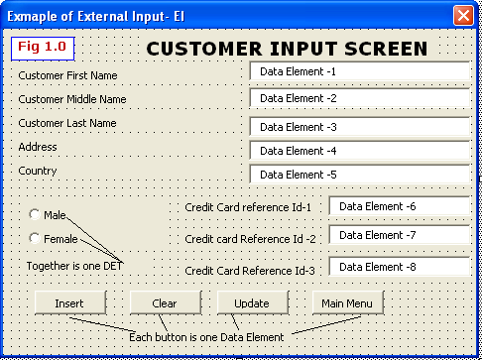
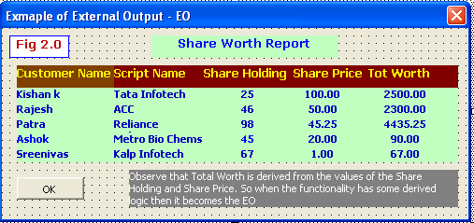
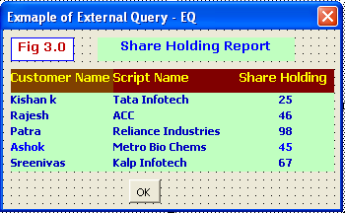

Slide 16
Transaction Components
External Input (EI): EI is a component which facilitates the data to enter into the system through an Input Screen or through other application.
External Output (EO): EO is a component which displays the data as a report, or sends formatted file as input to other application. The EO may update an ILF occasionally. The report will contain the derived data.
External Inquiry (EQ): EQ is a component which displays the data as a report, or sends formatted file as input to other application. The EQ will not update any ILF. The report will not contain the derived data.

Slide 17
Function Point Components
External Inputs
PAYROLL
SYSTEM
Employee IT
Declaration
External Outputs
Internal
Logical
Files (ILF)
EMPLOYEE PAYSLIP
IT PROJECTIONS
Application Boundary
External Inquiries
MY DATA
HR
SYSTEM
External
Logical
Files (ILF)
External Logical Files

Slide 18
Assigning Complexity
Complexity Matrix for ILF & EIF
RETs | DETs
 | 1-19 | 20-50 | >50
0-1 | Low | Low | Ave
2-5 | Low | Ave | High
>5 | Ave | High | High
Complexity Matrix for EI
FTRs | DETs
 | 1-4 | 5-15 | >15
0-1 | Low | Low | Ave
2 | Low | Ave | High
>3 | Ave | High | High
Complexity Matrix for EO, EQ
FTRs | DETs
 | 1-5 | 6-19 | >19
0-1 | Low | Low | Ave
2-3 | Low | Ave | High
>3 | Ave | High | High

Slide 19
Function Point Count
FP count for ILF & EIF
Complexity | Component
 | ILF | EIF
Low | 7 | 5
Average | 10 | 7
High | 15 | 10
FP count for EO,EQ,EI
Complexity | Component
 | EI | EO | EQ
Low | 3 | 4 | 3
Average | 4 | 5 | 4
High | 6 | 7 | 6

Slide 20
Unadjusted Function Point Count
FP component | The formula for each CELL is (Total FP components found ) x (FP count)
 | LOW | AVERAGE | HIGH | TOTAL (assume some values)
Internal Logical Files | ___ x 7 = ___ | ___ x 10 = ___ | ___ x 15 = ___ | 230
External Interface Files | ___ x 5 = ___ | ___ x 7 = ___ | ___ x 10 = ___ | 150
External Inputs | ___ x 3 = ___ | ___ x 4 = ___ | ___ x 6 = ___ | 125
External Outputs | ___ x 4 = ___ | ___ x 5 = ___ | ___ x 7 = ___ | 170
External Queries | ___ x 3 = ___ | ___ x 4 = ___ | ___ x 6 = ___ | 90
Total number of unadjusted function point counts - UAF |  |  |  | 765

Slide 21
Value Adjustment Factor (VAF)
General System Characteristic |  | Brief Description | Degree of Influence
1. | Data communications | How many communication facilities are there to aid in the transfer or exchange of information with the application or system? | 2
2. | Distributed data processing | How are distributed data and processing functions handled? | 0
3. | Performance | Was response time or throughput required by the user? | 3
4. | Heavily used configuration | How heavily used is the current hardware platform where the application will be executed? | 4
5. | Transaction rate | How frequently are transactions executed daily, weekly, monthly, etc.? | 5
6. | On-Line data entry | What percentage of the information is entered On-Line? | 1
7. | End-user efficiency | Was the application designed for end-user efficiency? | 1

Slide 22
General System Characteristic | Brief Description | Degree of Influence
8. | On-Line update | How many ILF’s are updated by On-Line transaction? | 1
9. | Complex processing | Does the application have extensive logical or mathematical processing? | 3
10. | Reusability | Was the application developed to meet one or many user’s needs? | 0
11. | Installation ease | How difficult is conversion and installation? | 3
12. | Operational ease | How effective and/or automated are start-up, back-up, and recovery procedures? | 2
13. | Multiple sites | Was the application specifically designed, developed, and supported to be installed at multiple sites for multiple organizations? | 1
14. | Facilitate change | Was the application specifically designed, developed, and supported to facilitate change? | 2
Total Degree of Influence - TDI |  |  | 28
VAF = 0.65 + (28/100) = 0.9
FP = UAF * VAF ➔ FP = 765 * 0.93 = 711.45

Slide 23
Function Point Estimation In Nutshell.
Set The Boundary
Identify Function Point Components
Derive the Unadjusted Function Point Count based on Complexities (DET/RETs)
Derive the Value Adjustment Factors (VAF)
FP = VAF * UFP

Slide 24
Other Estimates From Size
Application size is measured in Function Points
Effort and Productivity can be obtained from Size.

Slide 25
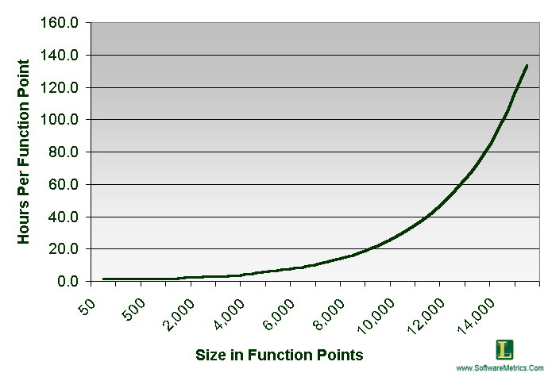
Effort Estimation From FP
Above graph depends upon historical data.

Slide 26
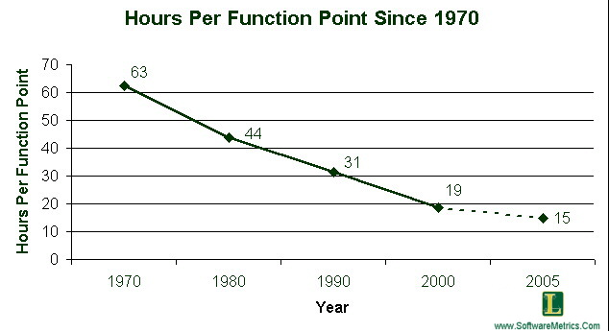
Productivity From FP
Above graph depends upon historical data.

Slide 27
Do’s And Don’ts
Where to Use:
  Development Projects
  Enhancement Project
  Sizing of any existing Application
Where Not Use:
  Bug Fixing Work
  Performance Tuning Work

Slide 28
References
International Function Point User Group (http://www.ifpug.org)
http://softwaremetrics.com

Slide 29
Thank You

